Slide 1
Week 2 Servlets/DB

Slide 2
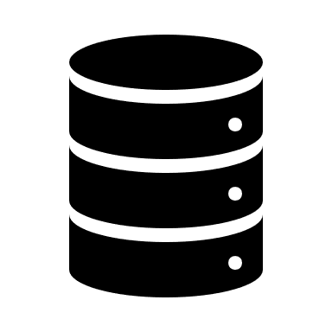
API vs Server
API: Application Programming Interface
Client
Server/ API

Slide 3
Programmatic APIs
Caller
API
Libraries

Slide 4
HTTP
HTTP: HyperText Transfer Protocol
Communication over a network often happens through some protocol
We are using http for most web application communication

Slide 5

Tomcat
Web Server / Listener / etc.
Web.xml
Client
App.war
GET /HelloServlet/something?name=john

Slide 6
Model
Request
Servlet
Service
DAO/Repository

